Slide 1
Operating Systems
Lecture 2

Slide 2
Agenda for Today
Review of previous lecture
Single-user systems
Batch systems
Multiprogrammed systems
Time-sharing systems
Real-time systems
Interrupts, traps, and signals
CPU, I/O, and memory protection
Recap of the lecture

Slide 3

Single User Systems
Personal computers – computer system dedicated to a single user.
Interactive
User convenience and responsiveness.

Slide 4
Single User Systems
Can adopt technology developed for larger operating systems—multi-process, multi-user
Individuals usually have sole use of computer and do not need advanced protection features.
May run several different types of operating systems (Windows, MacOS, UNIX, Linux)

Slide 5

Batch Systems
First rudimentary system.
User ≠ operator
Reduce setup time by batching similar jobs
Automatic job sequencing – automatically transfers control from one job to another.
Resident monitor :
  initial control in monitor
  control transfers to job
  when job completes control transfers back to monitor

Slide 6

Memory Layout

Slide 7

Multiprogrammed Systems
Several jobs are kept in main memory at the same time, and the CPU is multiplexed among them.

Slide 8
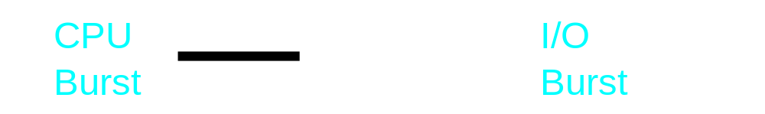


Multiprogrammed Systems
Example: Two processes P1 and P2 with CPU and I/O bursts of one time unit each

Slide 9
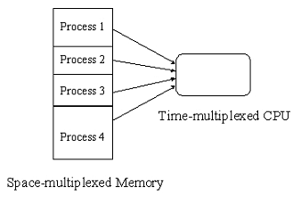
OS Features Needed for Multiprogramming
SPOOLing (Simultaneous Peripheral Operation On-Line)
Memory management
CPU scheduling

Slide 10

Time-sharing Systems
An interactive system with multiprogramming
A job is swapped in and out of memory to the disk if needed.
On-line file system must be available for users to access data and code.

Slide 11

Real-time Systems
Well-defined fixed-time constraints.
Often used as a control device in a dedicated application such as controlling scientific experiments, medical imaging systems, industrial control systems, and some display systems.
Real-Time systems may be either hard or soft real-time.

Slide 12
Real-time Systems …
Hard real-time systems:
  Secondary storage limited or absent, data stored in short term memory, or read-only memory (ROM)
  No virtual memory—time cannot be “wasted” on translation of logical to physical addresses
  OS code structured for efficiency
  Plane landing systems, process control in nuclear power plants, respirators, etc.

Slide 13
Real-time Systems ...
Soft real-time systems
  Output should be produced within the given time constraints but if it is not, the result is not life threatening
  Useful in applications (multimedia, virtual reality) requiring advanced operating-system features.

Slide 14


Interrupts, Traps, and Signals
The occurrence of an event is usually signaled by an interrupt from either the hardware or the software.
Hardware may trigger an interrupt at any time by sending a signal to the CPU usually by way of the system bus.
Software may trigger an interrupt by executing a special operation called a system call.
Answer the Phone
.
.
.
Resume

Slide 15
Interrupts, Traps, and Signals
A process can generate a trap, for example, by dividing a number by zero.
A user or a process may generate a signal (an interrupt to a process)
Answer the Phone
.
.
.
Resume

Slide 16
Interrupt Handling
Interrupt transfers control to the interrupt service routine, generally, through the interrupt vector, which contains addresses of all the interrupt service routines.
Interrupt architecture must save the address of the instruction after the interrupted instruction and the CPU state so that execution of the interrupted process may continue after the interrupt has been serviced.

Slide 17
Interrupt Handling …
Incoming interrupts are disabled while another interrupt is being processed to prevent lost interrupts.
An operating system is interrupt driven.

Slide 18
Hardware Protection
Dual-Mode Operation
I/O Protection
Memory Protection
CPU Protection

Slide 19
Dual-Mode Operation
Sharing system resources requires operating system to ensure that an incorrect program cannot cause other programs to execute incorrectly.
Provide hardware support to differentiate between at least two modes of operations.
  User mode – execution done on behalf of a user.
  Monitor mode (also kernel mode or system mode) – execution done on behalf of operating system.

Slide 20
Dual-Mode Operation …
Mode bit added to computer hardware to indicate the current mode: monitor (0) or user (1).
When an interrupt or fault occurs hardware switches to monitor mode.
Interrupt/fault
monitor
user
set user mode
Privileged instructions can be issued only in monitor mode.

Slide 21
Recap of Lecture
Single-user systems
Batch systems
Multiprogrammed systems
Time-sharing systems
Real-time systems
Interrupts, traps, and signals
Privileged instructions
I/O protection
Recap of the lecture

Slide 22
Operating Systems
Lecture 2

